Slide 1
Cryptocurrency Price prediction
GROUP 4
1. Diya Baldota -NUID 002747966 2. Hardik Sodhani -NUID 002770306 3. Rucha Chotalia -NUID 002711888 4. Shreyansh Goushal – NUID 002754437

Slide 2
CONTENTS
Objectives
Architecture Diagram
ER Diagram+ Document Data Model
Graph Data Model
Visualizations using PowerBi

Slide 3
Objective
To create a cryptocurrency price prediction model using Azure Multi-Model Dataset
Data platform: Azure's data platform will be used to gather data from multiple sources
Preprocessing: Data will be preprocessed to ensure its quality and relevance for the model
Machine learning: A machine learning model will be built considering multiple factors to predict cryptocurrency prices
Evaluation: The model will be evaluated to choose the best version
Deployment: The best version of the model will be deployed on the Azure platform for real-time predictions
Ultimate goal: To provide a reliable tool for traders and investors to make informed investment decisions

Slide 4
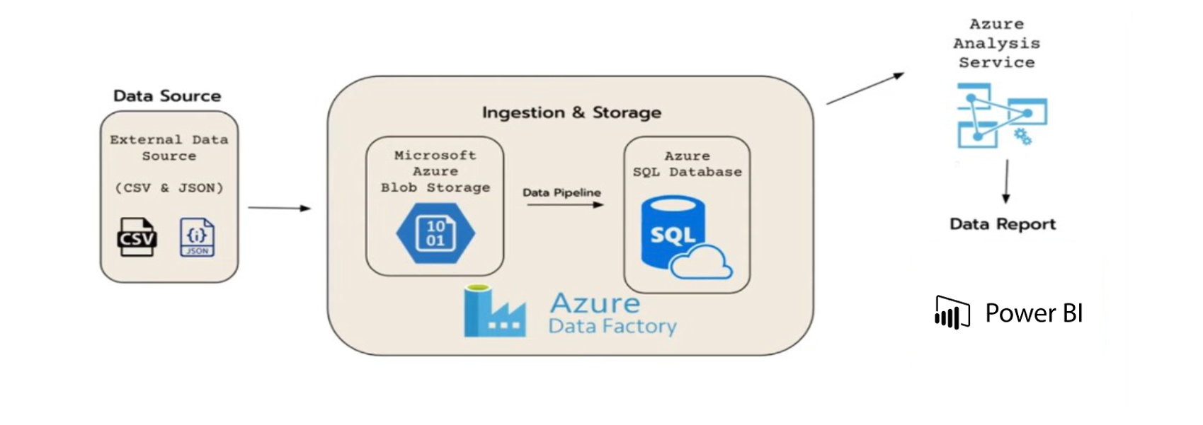
ARCHITECTURE

Slide 5
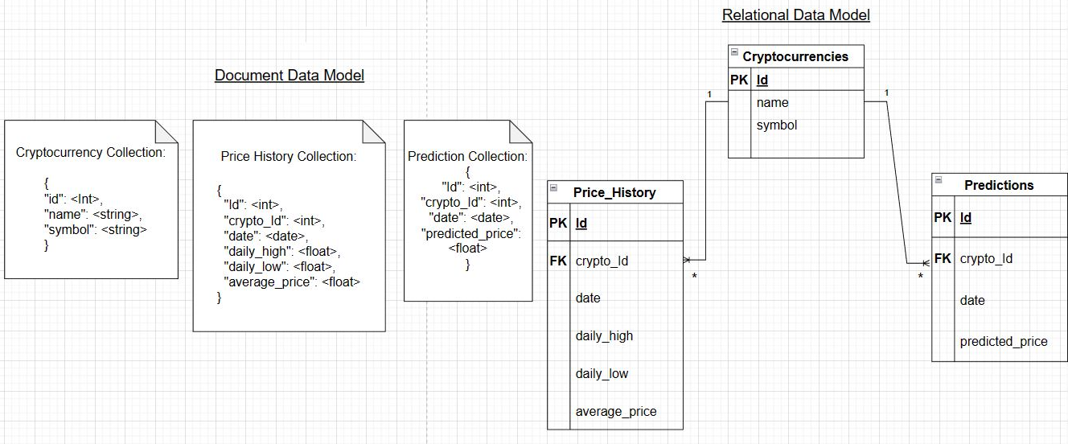
ER DIAGRAM+ document model

Slide 6
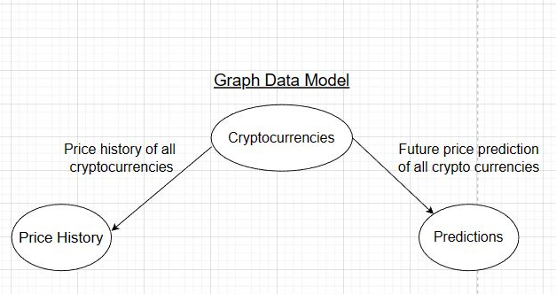
Graph Data Model

Slide 7
THANK YOU

